Slide 1
CityLoops
Closing the loop for urban material flows
WP2: Construction and demolition waste incl. soil
Pernille Kernel, Capital Region of Denmark

Slide 2
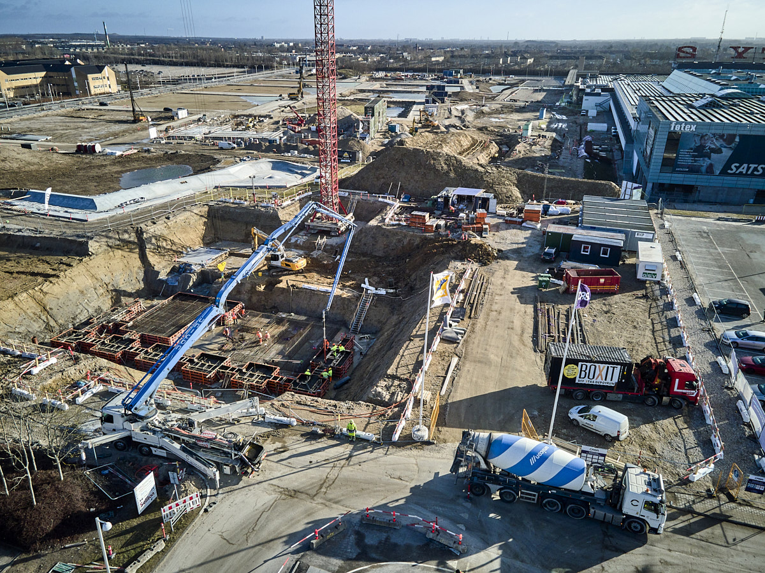
Why circular construction
The construction sector in Europe:
Roughly half of all material extraction
40% of greenhouse gas emissions
Largest waste stream in the EU
70% of the recycled construction material is used for backfilling or as a road base
The demand for raw materials is almost 6 tonnes per capita annually
Only 10.6% of this comes from recycled or reused sources
Photo by Unicon

Slide 3
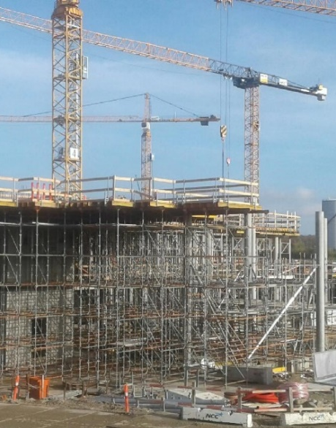
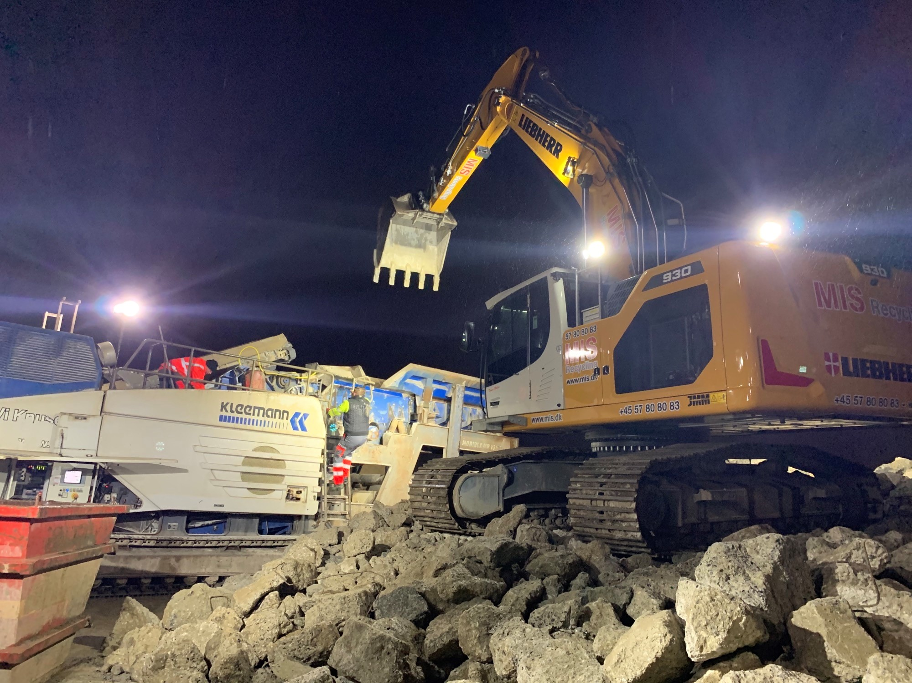
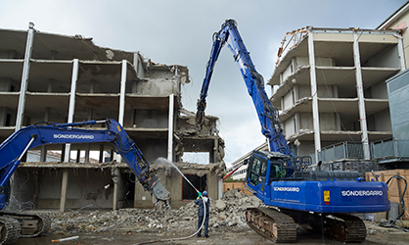
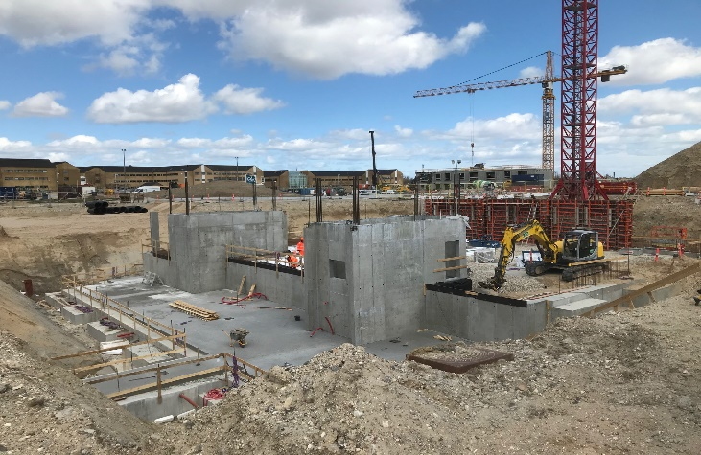
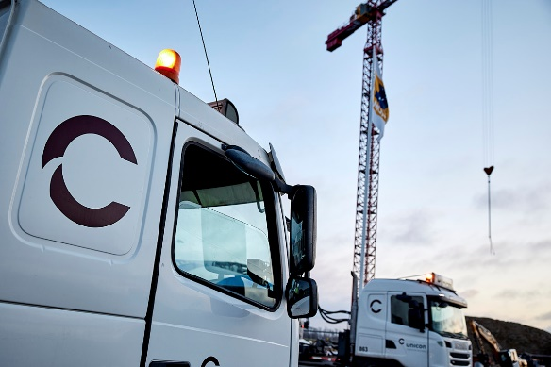
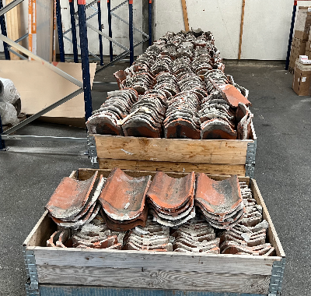
”If only the construction clients would ask for selective demolition, we would be ready”
”The contractor, the demolisher and the architect have to sit down and choose available secondary resources early in the construction project”
”If the consultants would only be more open to experiments we could include reused materials in our designs”
Supplier of reused materials
Demolisher
Construction Client
Architect
Consultant
Contractor
”Producers of secondary construction materials should certify their products. Then we would recommend using them”
”If the architects were able to see the accesible reused materials, they would include them in their design”
”If the market cannot provide the right amount of materials at the right time it wont work”
Notes:
All the different actors in the construction value chain point to other actors to improve circularity – and these are all necessary actions, which means we all need to act, to change our way of thinking and stop doing business as usual - In order to create a well-functioning market for adaptive reuse of buildings as well as reuse and recycvling of materials into new construction.

Slide 4
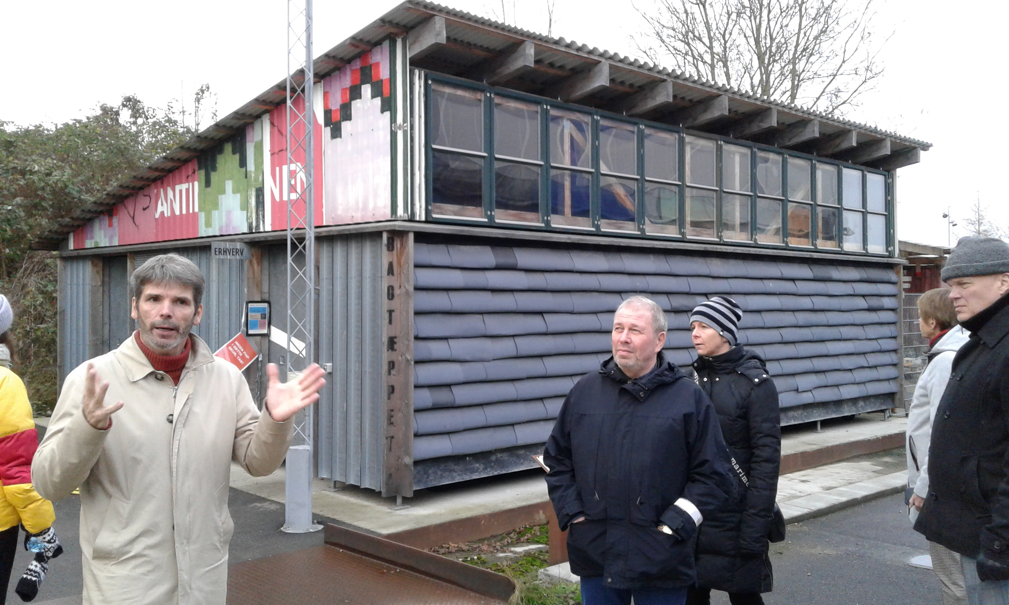
The CityLoops CDW focus
CityLoops is a Horizon2020 project with partners from six cities in Europe developing methods and instruments and demonstrating solutions for construction and demolition waste to be reused or recycled - again and again.
Timespan: 1/9 2019 to 1/10 2023
Partner cities:
Apeldoorn
Bodø
Mikkeli
Høje Taastrup
Roskilde
Sevilla
Notes:
Pernille

Slide 5
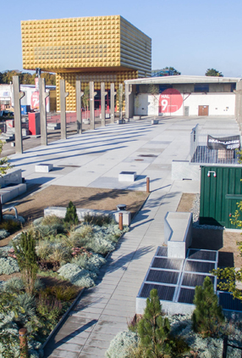
Demonstration actions
Seville: Replacing old water and sewage infrastructure and optimizing sorting and handling of CDW
Mikkeli: Screening and selective demolition of Pankalampi Health Care Centre and Tuukkala Hospital developing databank and marketplace
Bodø: Demolition and urban development of old military airport to new city area, creating a Digital Twin and reusing structures and resources
Apeldoorn: Renovation of Grieffersfeld road, testing new scanning methods for mapping materials and reusing them locally
Roskilde: Transformation and partial demolition of old factory halls and circular construction of parking houses, recycling concrete and circular soil handling
Høje-Taastrup: Recycling concrete from demolition of housing in foundation of the new City Hall, circular soil management and circular criteria in sale of old City Hall

Slide 6
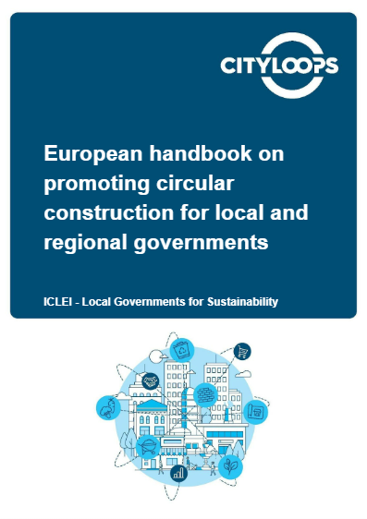
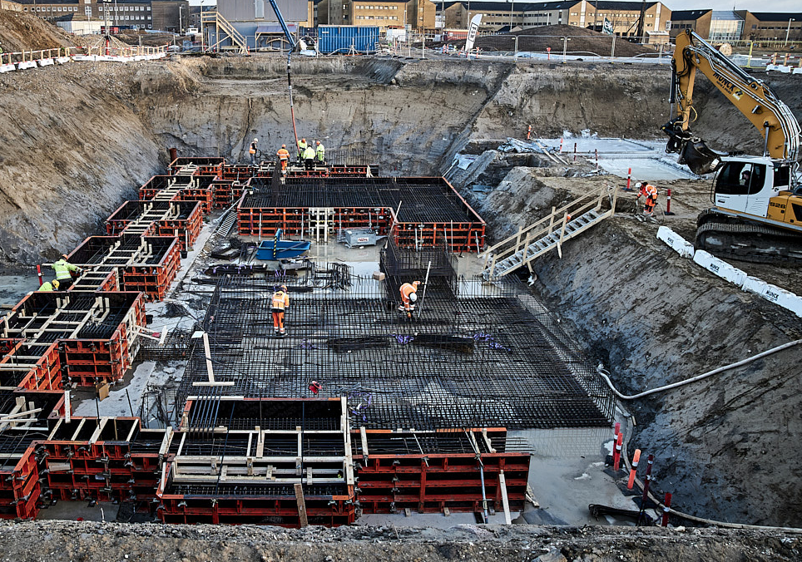
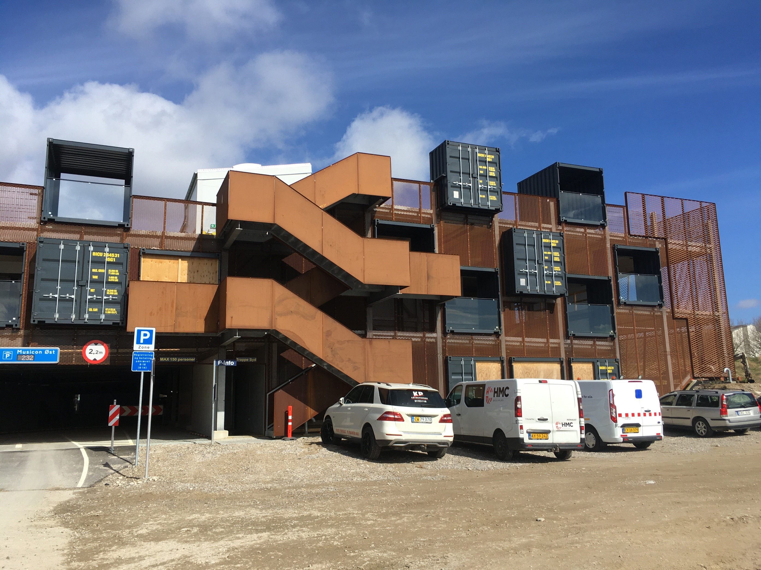
1 handbook and 9 toolboxes with instruments and demonstration experiences
1) Planning and decision-making
2) Stakeholder engagement
3) Circular demolition
4) Data and material passports
5) Material banks and marketplaces
6) Recycling concrete
7) Circular soil handling
8) Circular procurement
9) Business cases
Notes:
Pernille

Slide 7
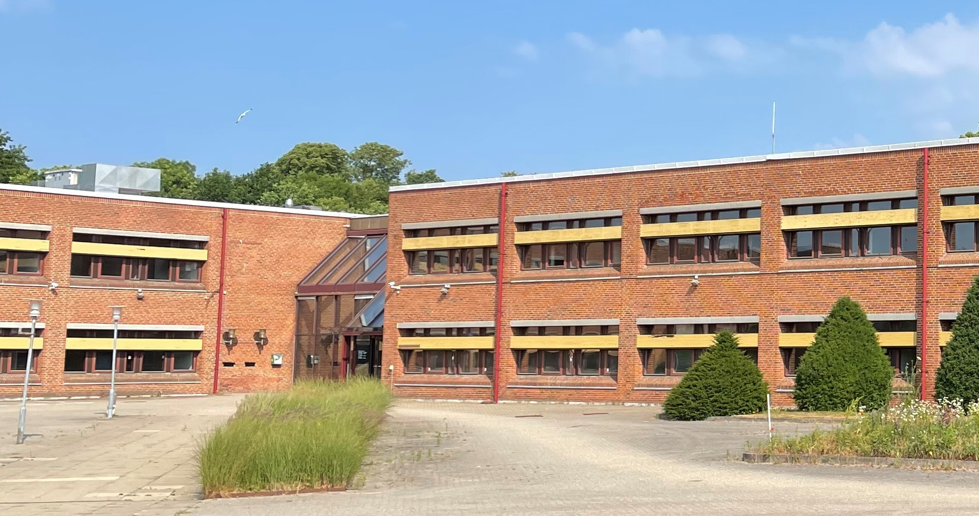
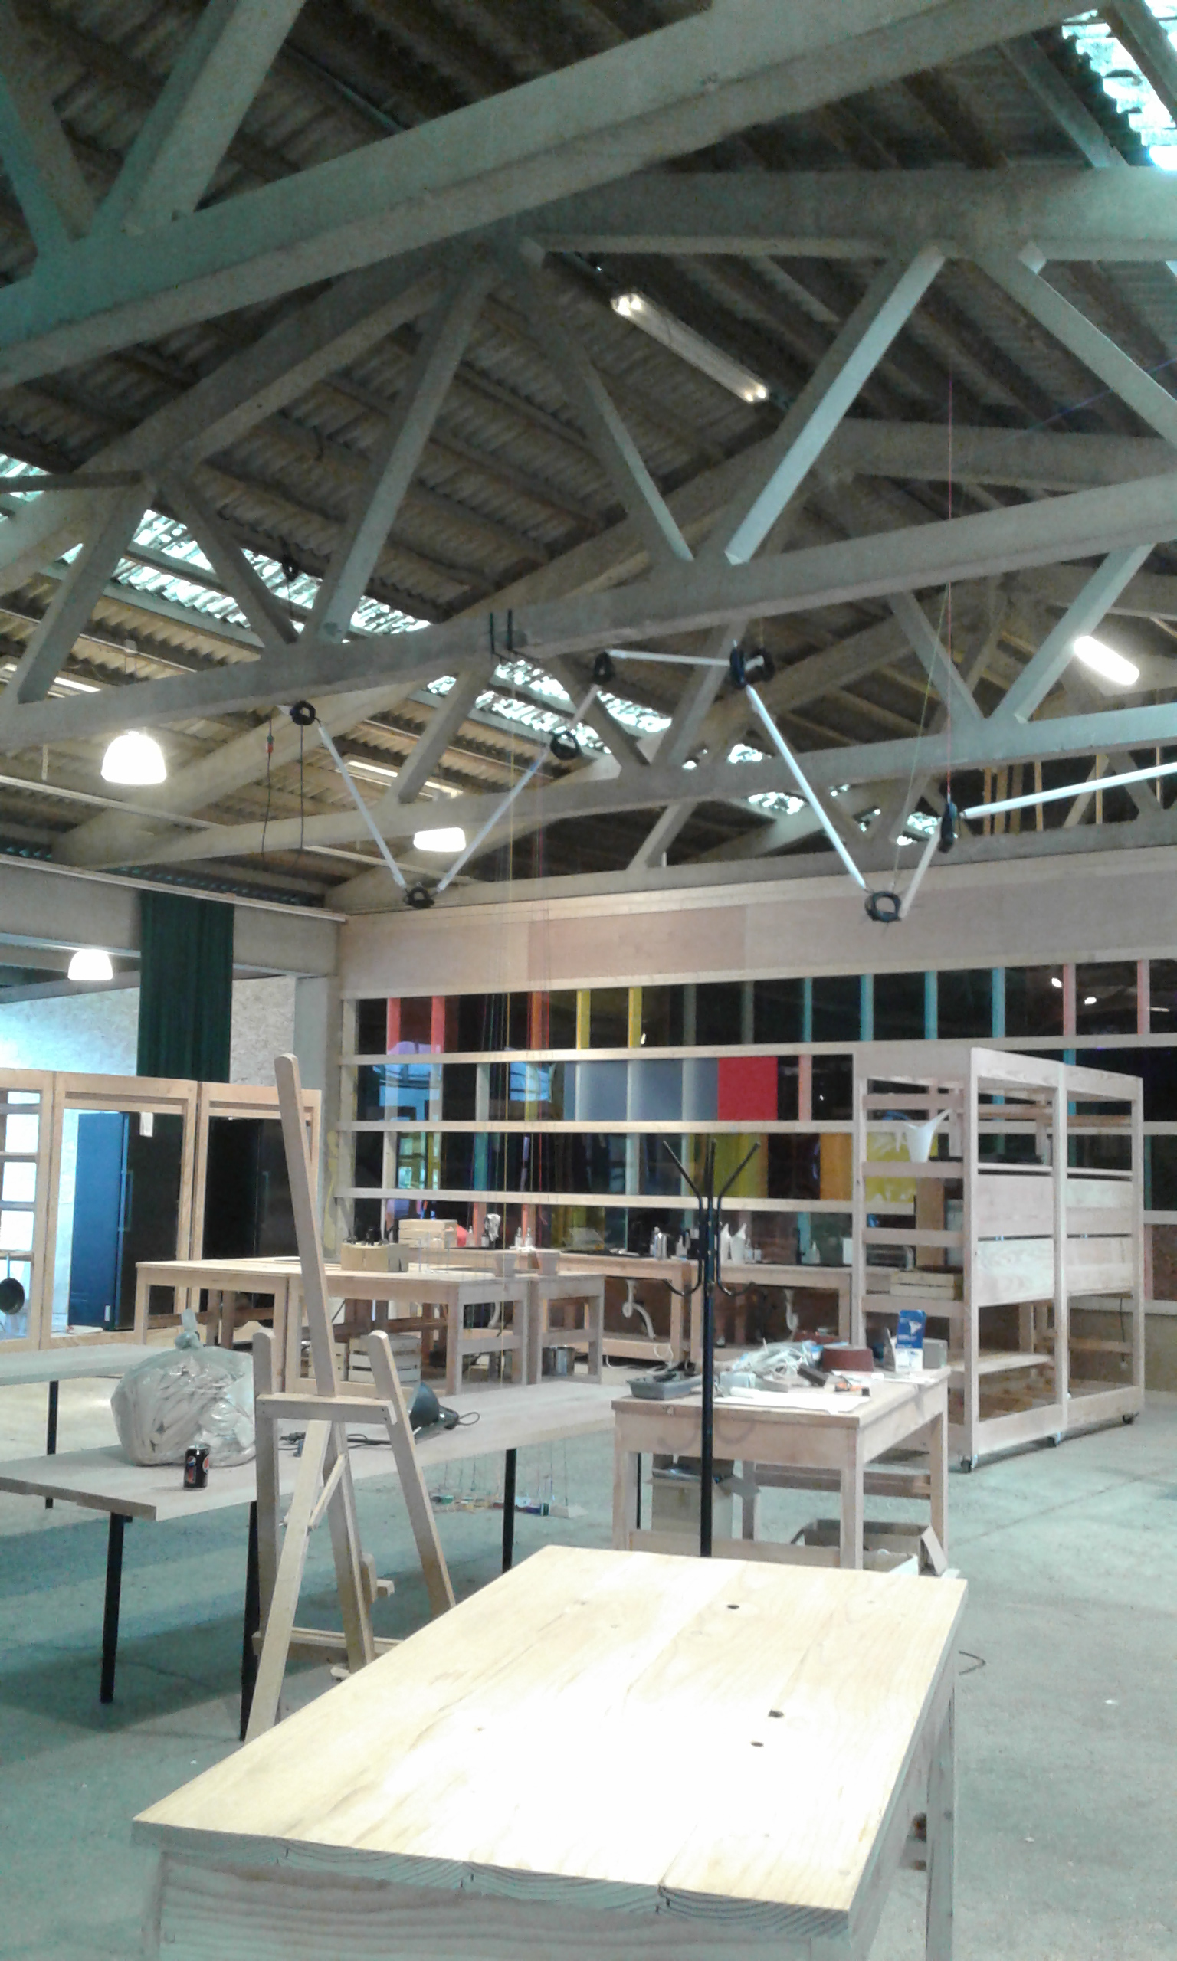
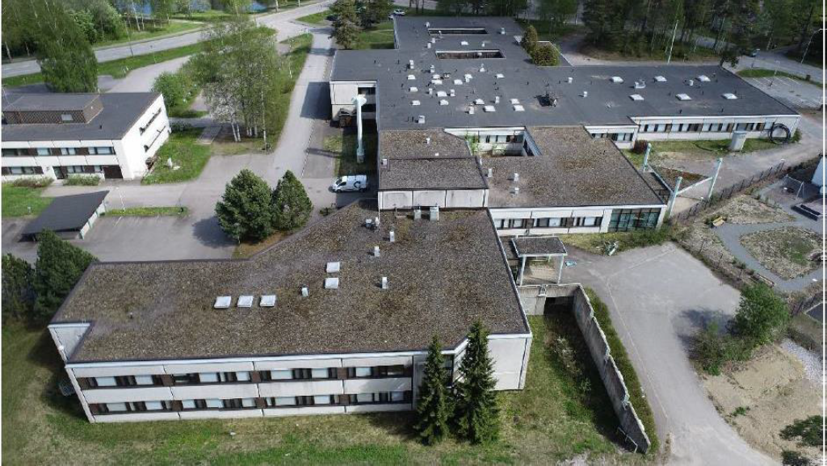
CityLoops experiences
Roskilde
Transformation of factory hall
Høje Taastrup
Transformation of Old Town Hall
Mikkeli
Tuukkala Hospital
Høje Taastrup
New town hall with recycled concrete
Foto: Unicon
Roskilde
New P-house designed for disassembly
Mikkeli
Pankalampi Health Care Centre
Notes:
I will dive a bit into the demo actions in HT and Ros as they are very relevant to Mikkeli – and leave Mikkeli to present your own CityLoops achievements – but I will just say, that without Mikkeli we would not have had the Guide for Pre-Demolition audits or the knowledge of using drones for screening buildings and estimating amounts of CDW on-site. ☺

Slide 8
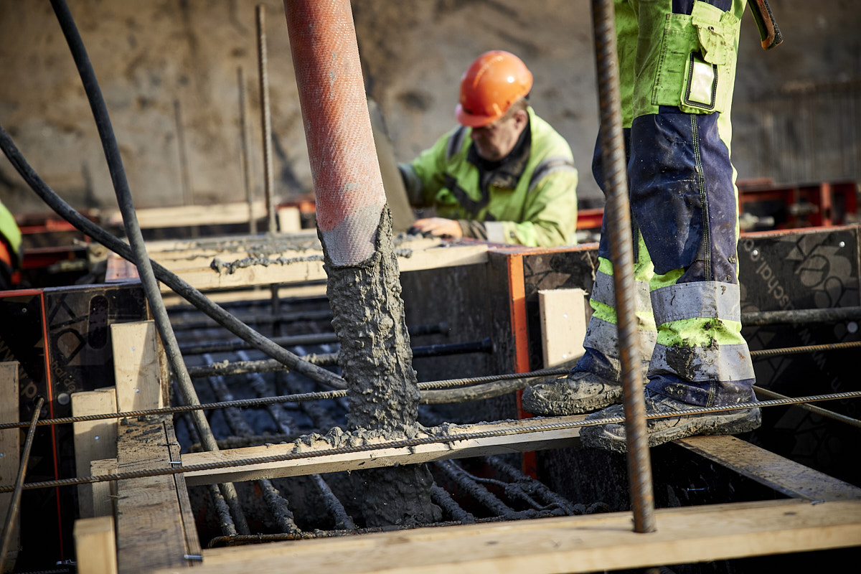

The value chain for recycling concrete
Existing structures
New concrete
SELETIVE DEMOLITION
CLEAN CONCRETE
CRUSHING
SIEVING
PLANNING
TESTING
WATERING
CONCRETE MIXING
CONCRETE
CASTING

Slide 9
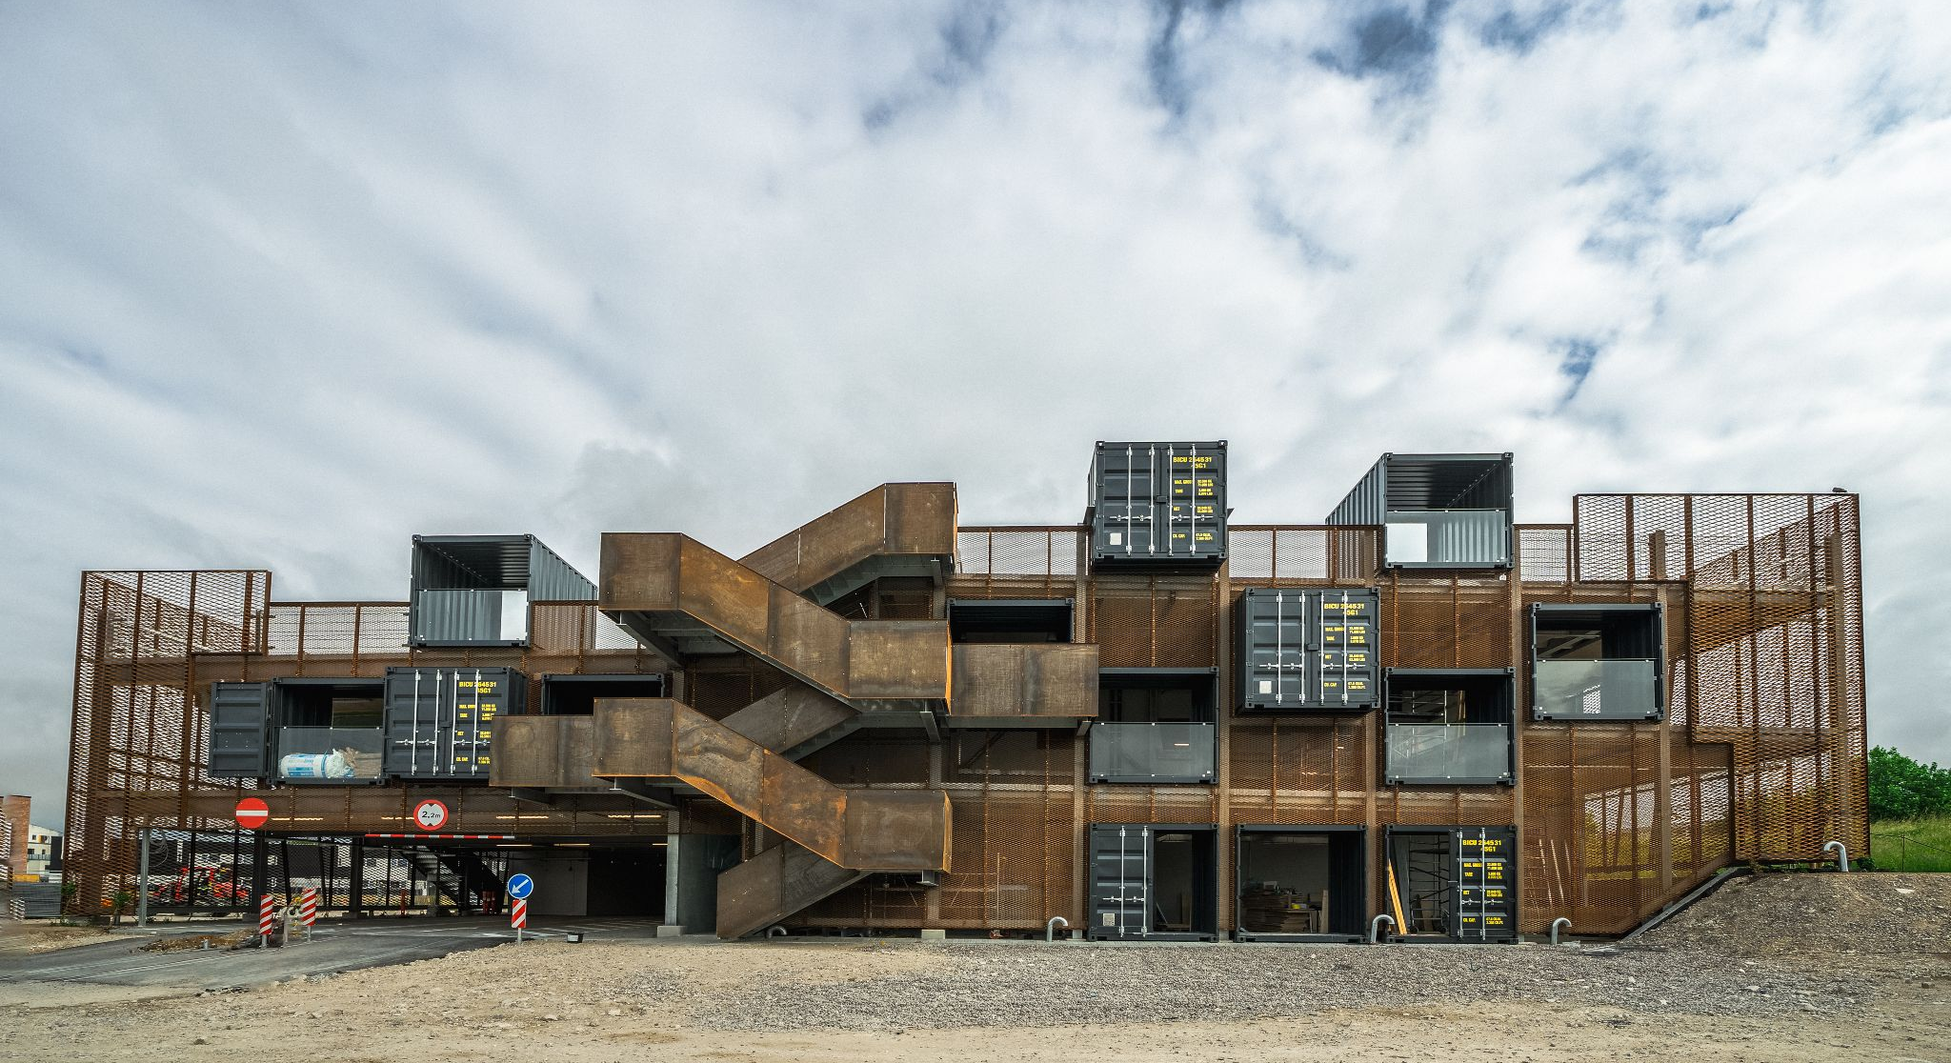


Roskilde Municipality
Parking House “INDFALDET”
Crushing and recycling concrete on-site
Built 2021-2022

Slide 10
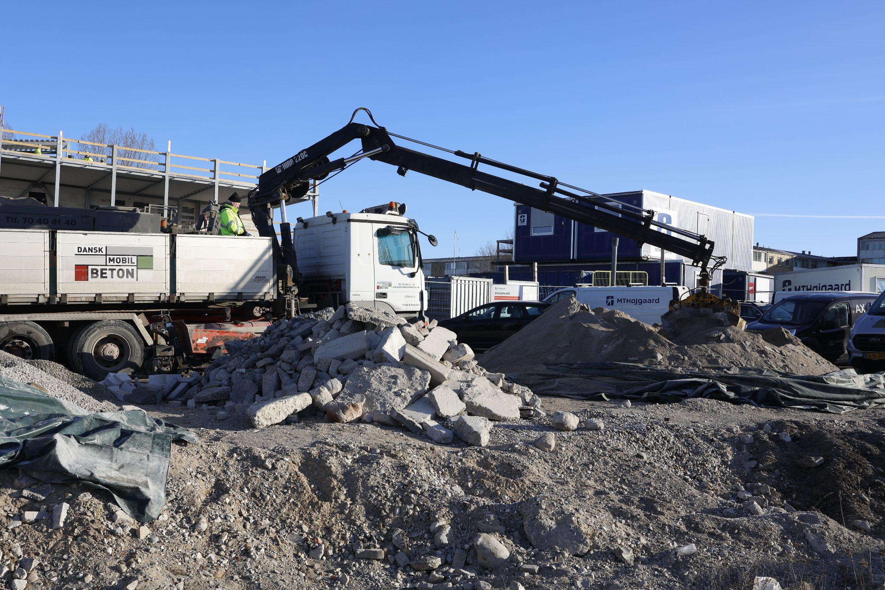
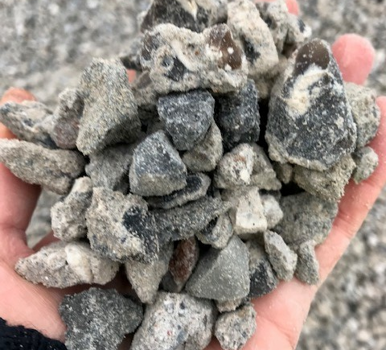
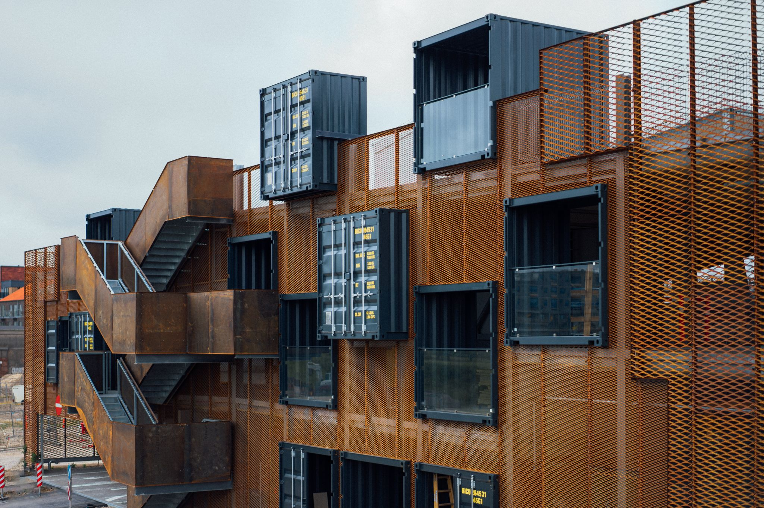
Tender process
Total contracting was offered as a tender with negotiation in accordance with the Public Procurement Act
Used criteria with a focus on circular economy in operation:
  Construction solutions with the highest reduction of materials as possible, including load-bearing structures, coatings, and installations
  Material with a high degree of recyclability
  Considerations regarding cleaning and operation clearly included in the design of the house
  Considerations regarding total energy included as a parameter in the choice of materials
In addition, demands were made in the tender material for recycling and circular economy e.g., reinstatement of crushed concrete and soil balance on the overall project

Slide 11
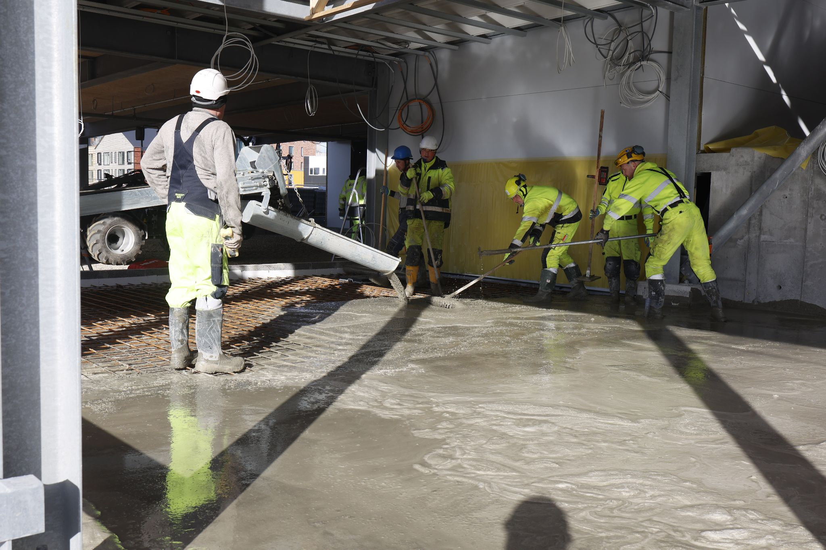
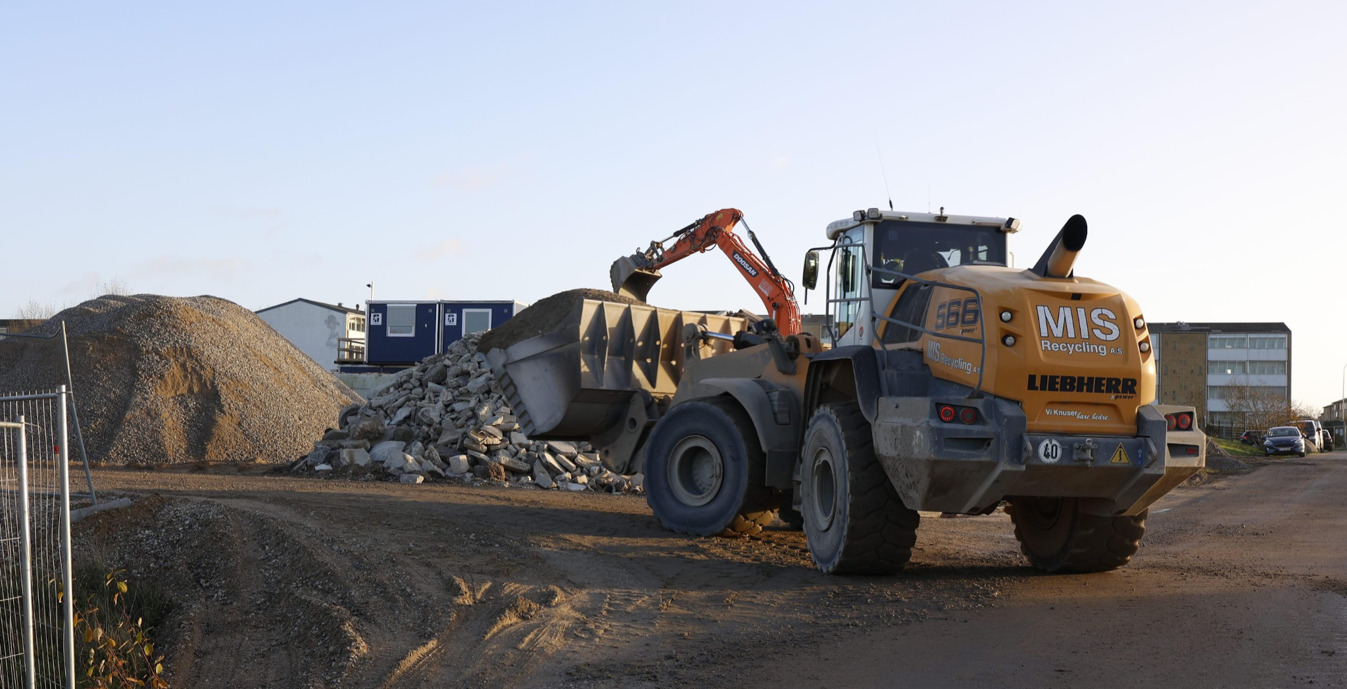
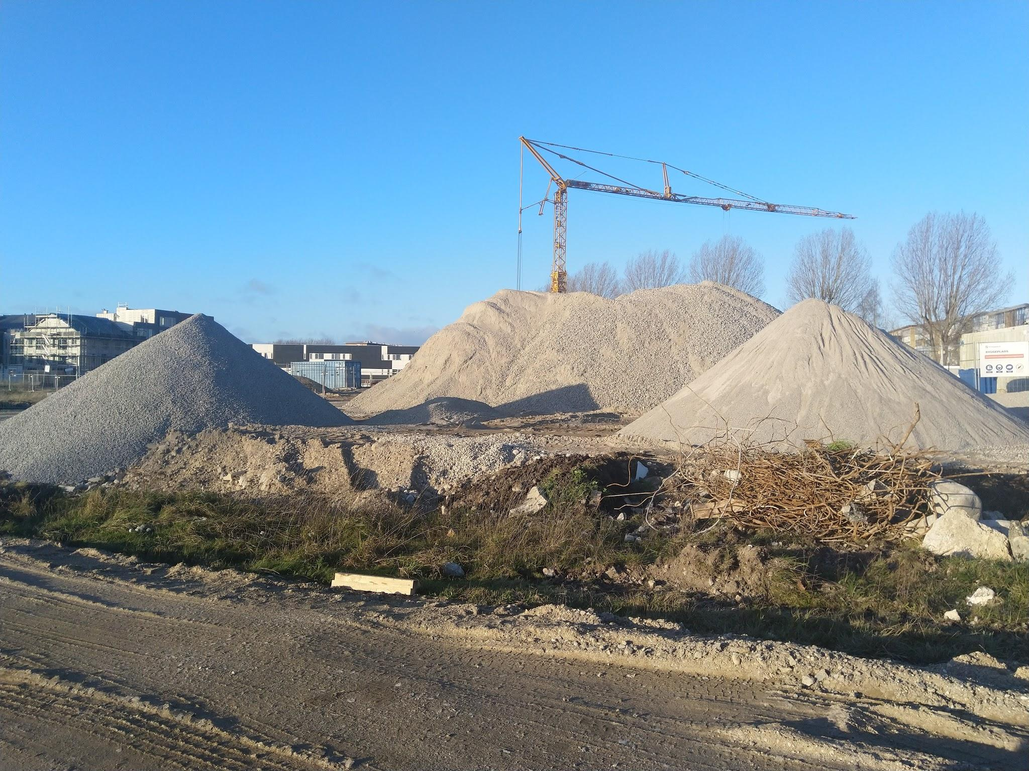
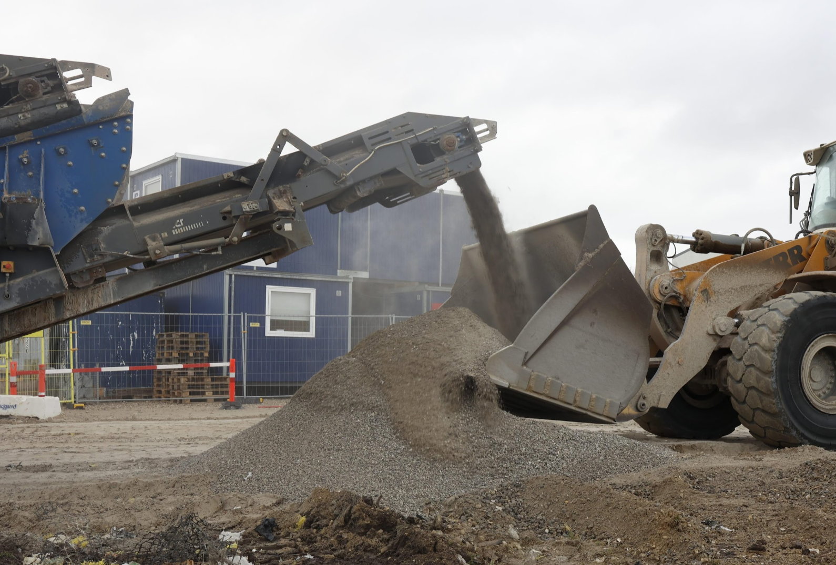
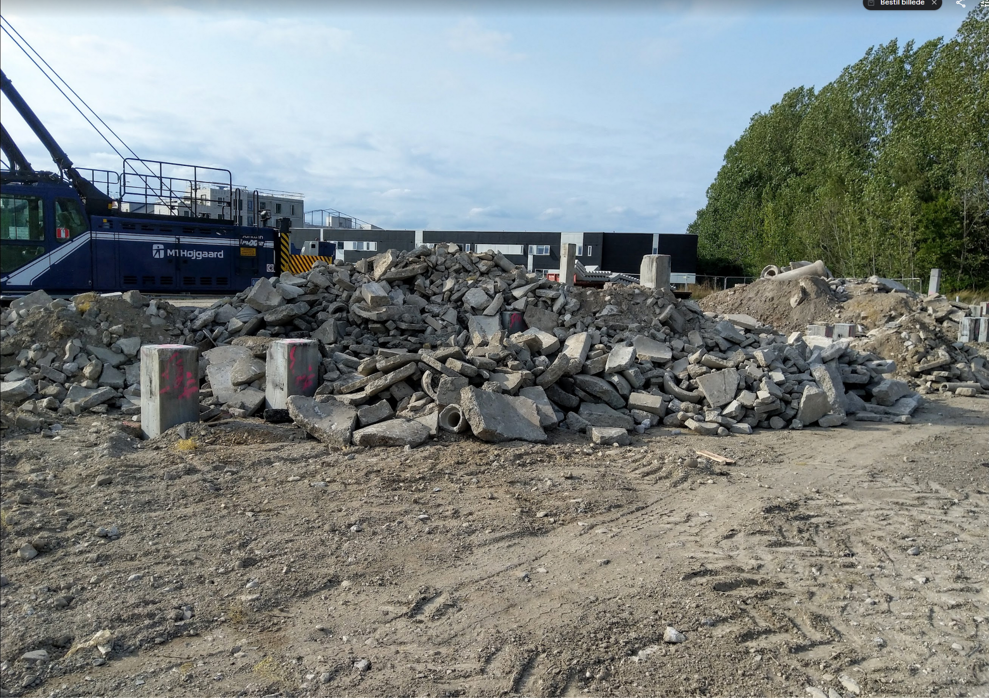
Construction process
Awareness of obstacles in the ground (the site was an old production facility for a concrete factory)
Collaboration between the municipality/client and the total contractor about solutions:
Excavation of 1.100 tons of mixed concrete and soil - placed in an intermediate depot immediately outside the construction site
Installation of a mobile crushing plant on-site and crushing into two pure concrete fractions (0-4 and 4-22 mm) for aggregate in new on-site concrete and one mixed fraction (0-32 mm) for gravel fill
Almost 53,000 € and 6-tons CO2 has been saved on demolition, loading and disposal of concrete residues, as well as on the price for new gravel and aggregates
The solution was buildable and profitable for all parties

Slide 12
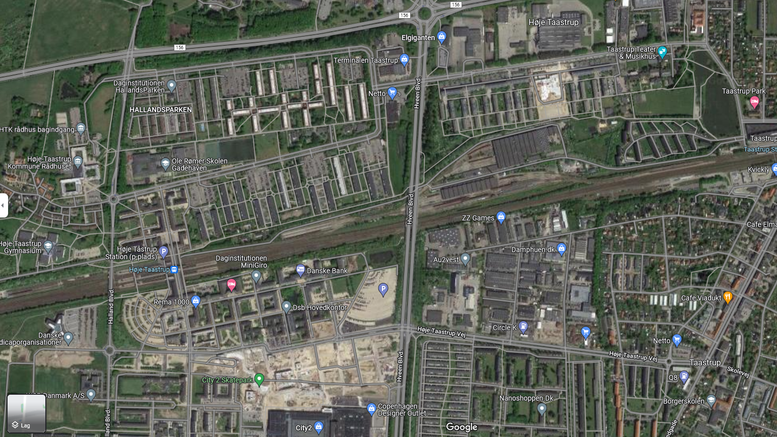
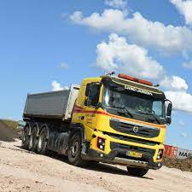
Høje Taastrup
Concrete from Taastrupgård to New City Hall
Soil from new City Hall to Taastrupgaard
Executed 2021-2022
9,000 t. soil
1,100 t. concrete for aggregate

Slide 13
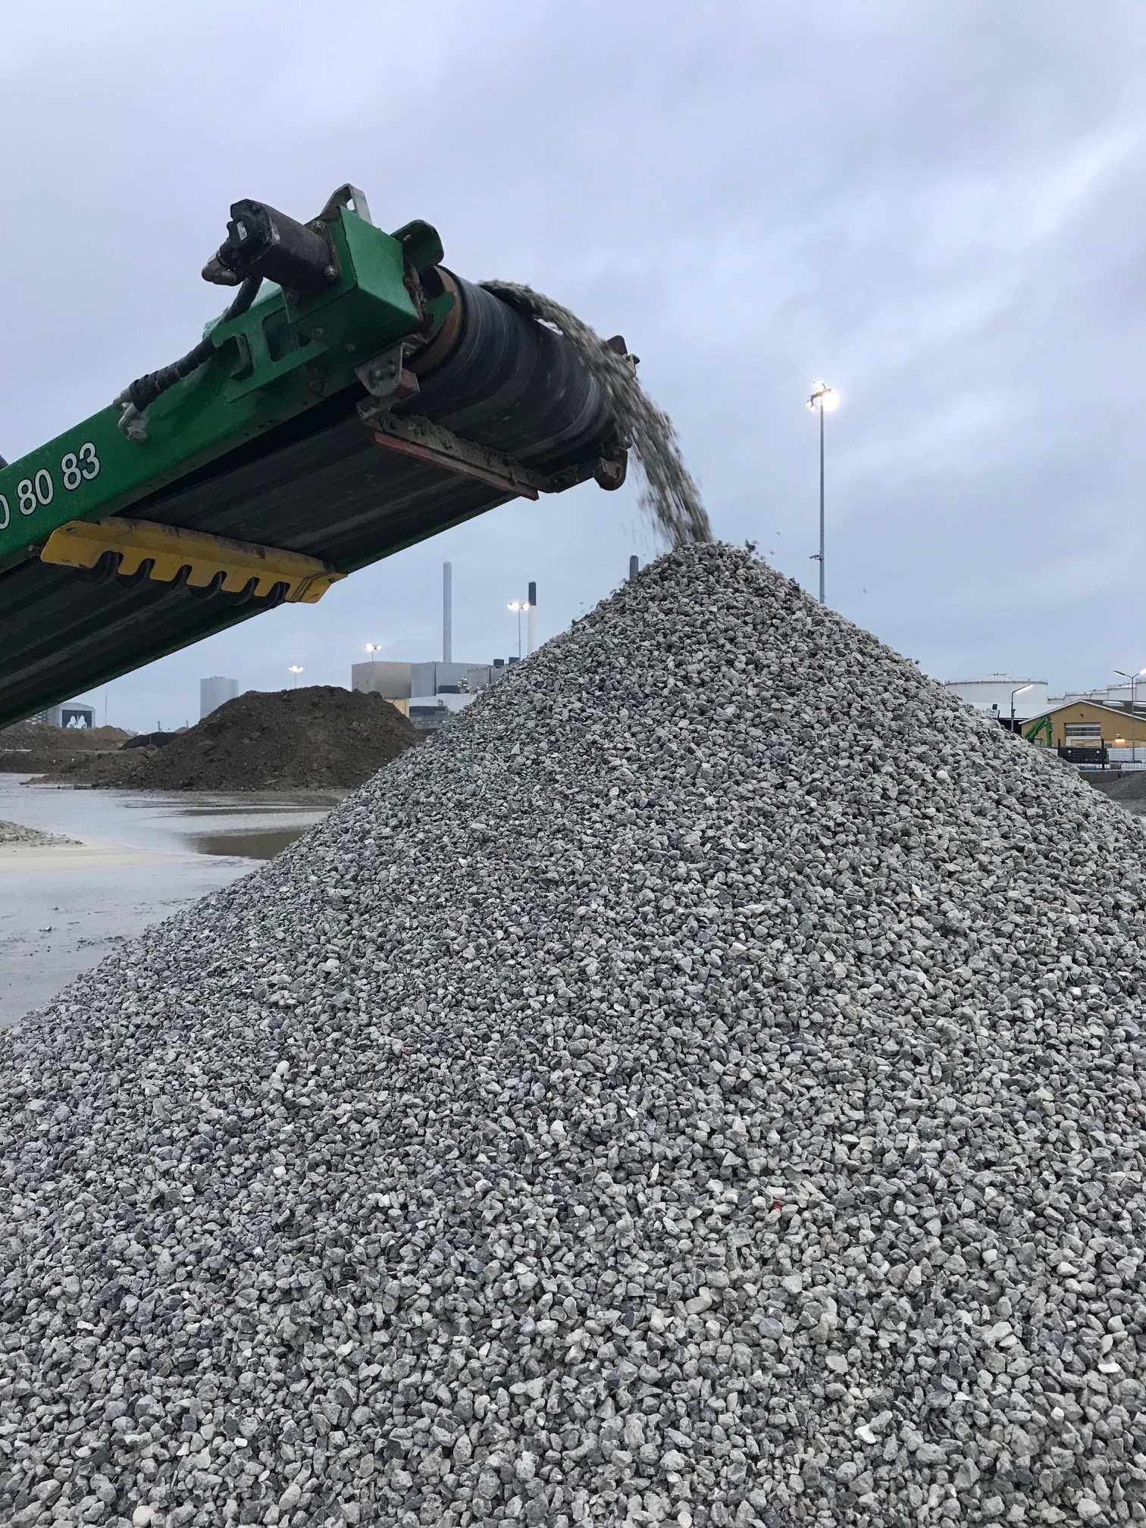
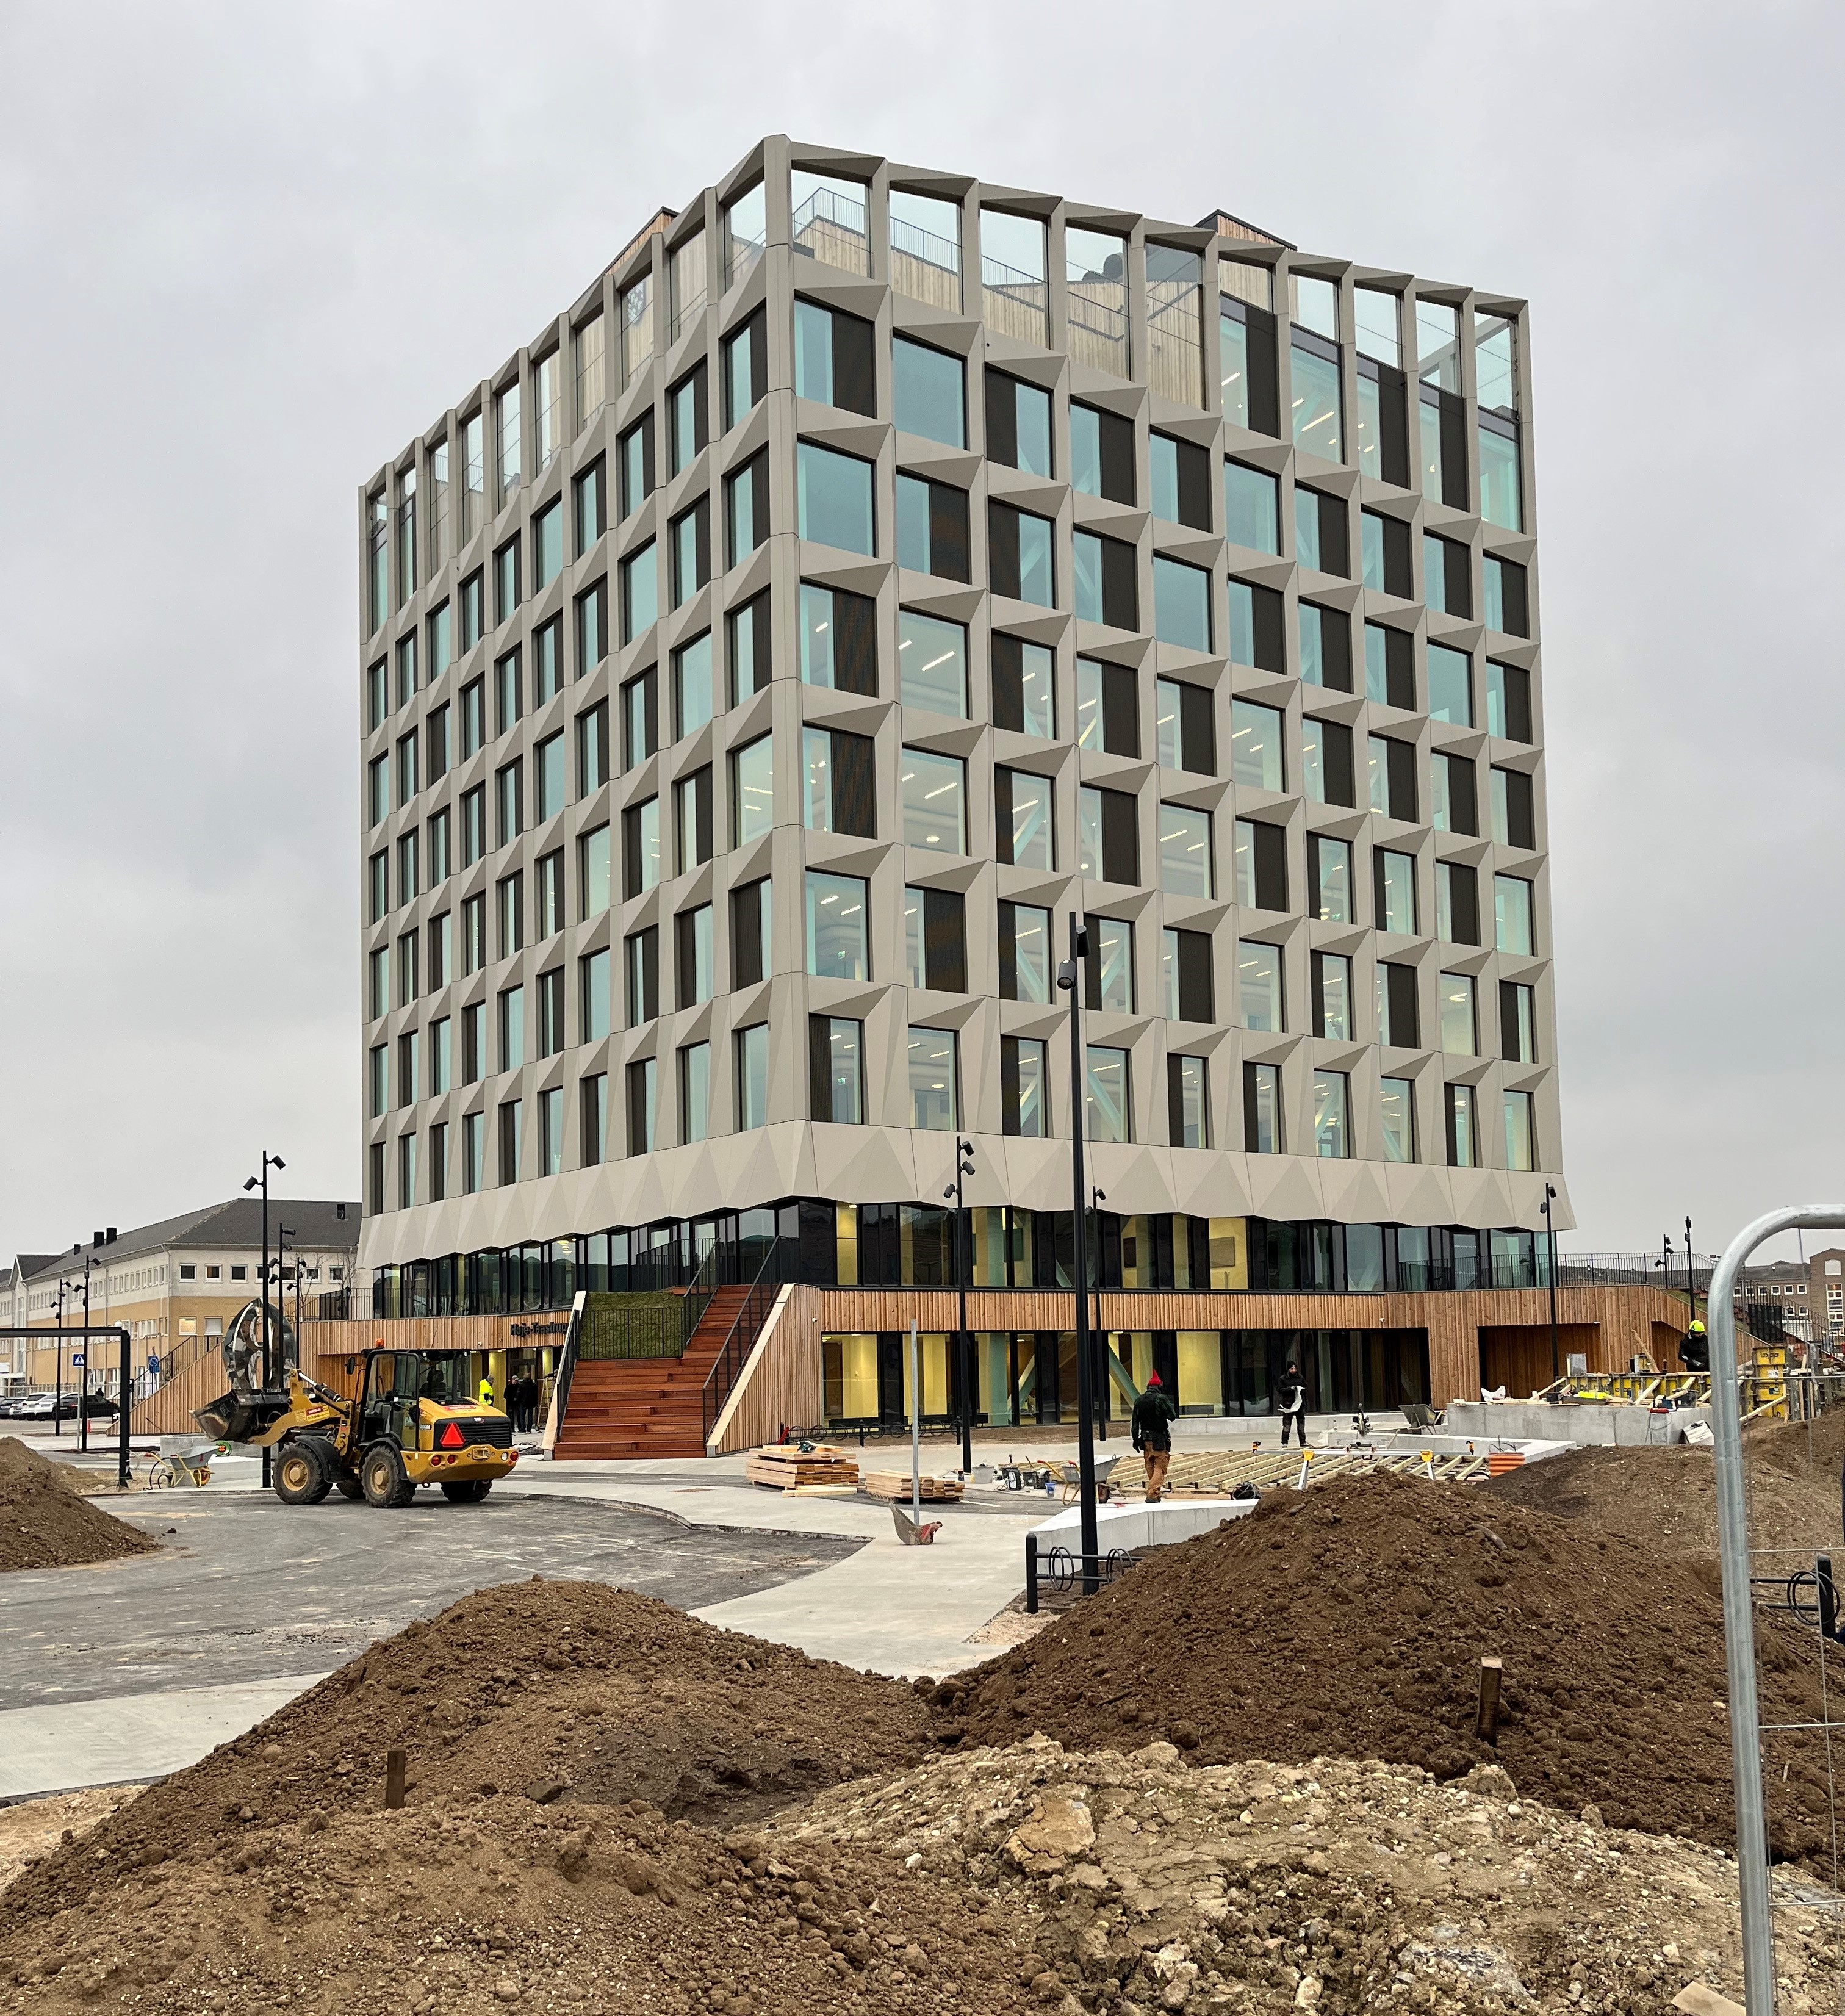
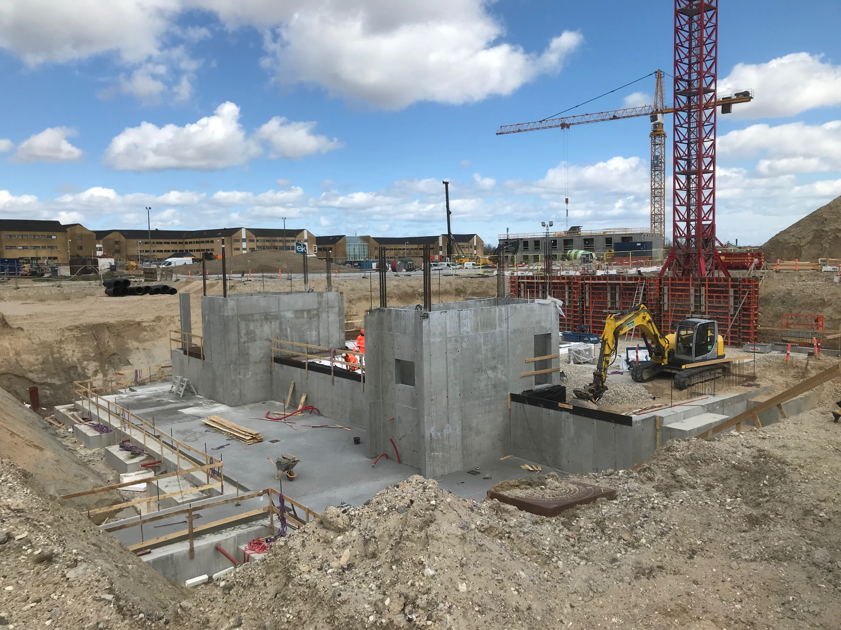
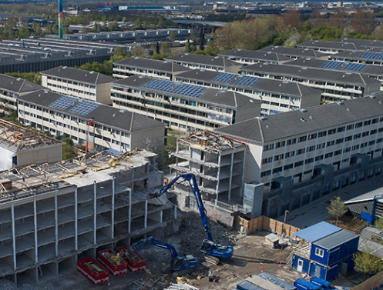
Recycling concrete in Høje Taastrup
Tendering criteria: “In connection with the construction of the city hall, the municipality wishes that reusable materials are used wherever possible. We have a special focus on the use of recycled concrete since we have access to a large amount of concrete waste from a local demolition.”
1.100 ton demolished concrete was crushed and recycled as aggregate in the foundation of the new town hall
Norrecco (crushing the concrete) and Unicon (mixing and delivering the concrete) both decided that their price for recycled concrete should not be above market price for normal concrete
The added cost compared to new concrete is 7 € per ton primarily from extra testing and consultancy
Risk aversiveness the greatest challenge

Slide 14

Local reuse of soil
9,000 ton of uncontaminated soil from the excavation of the cellar and foundation at the new town hall was used for landscaping at Taastrupgård
The soil had to be stored for two weeks before Taastrupgård could receive it
The distance between the two sites is 3 km
The estimated alternative was depositing the soil at land recipients around 25 km away and getting soil for Taastrupgaard from at least 25 km away
33 tons of CO2 was saved from transporting 9,000 ton of soil 3 km instead of 50 km
140.000 € was saved on transport and deposit of soil

Slide 15
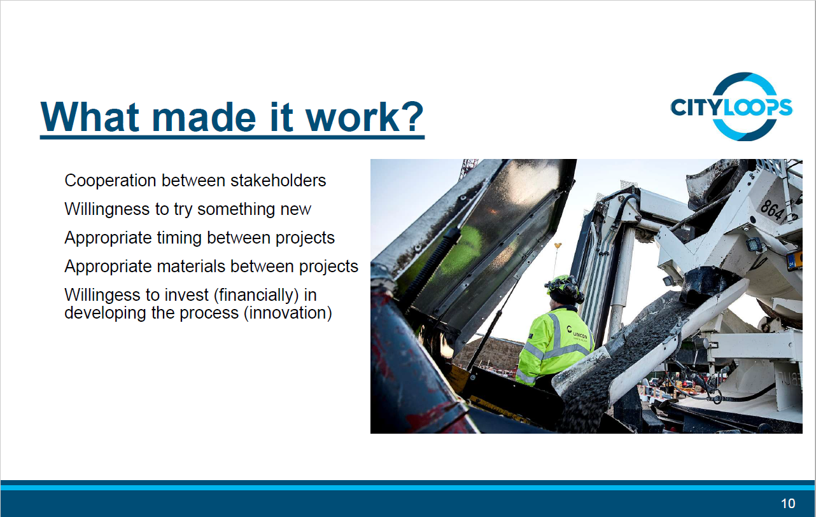

Slide 16
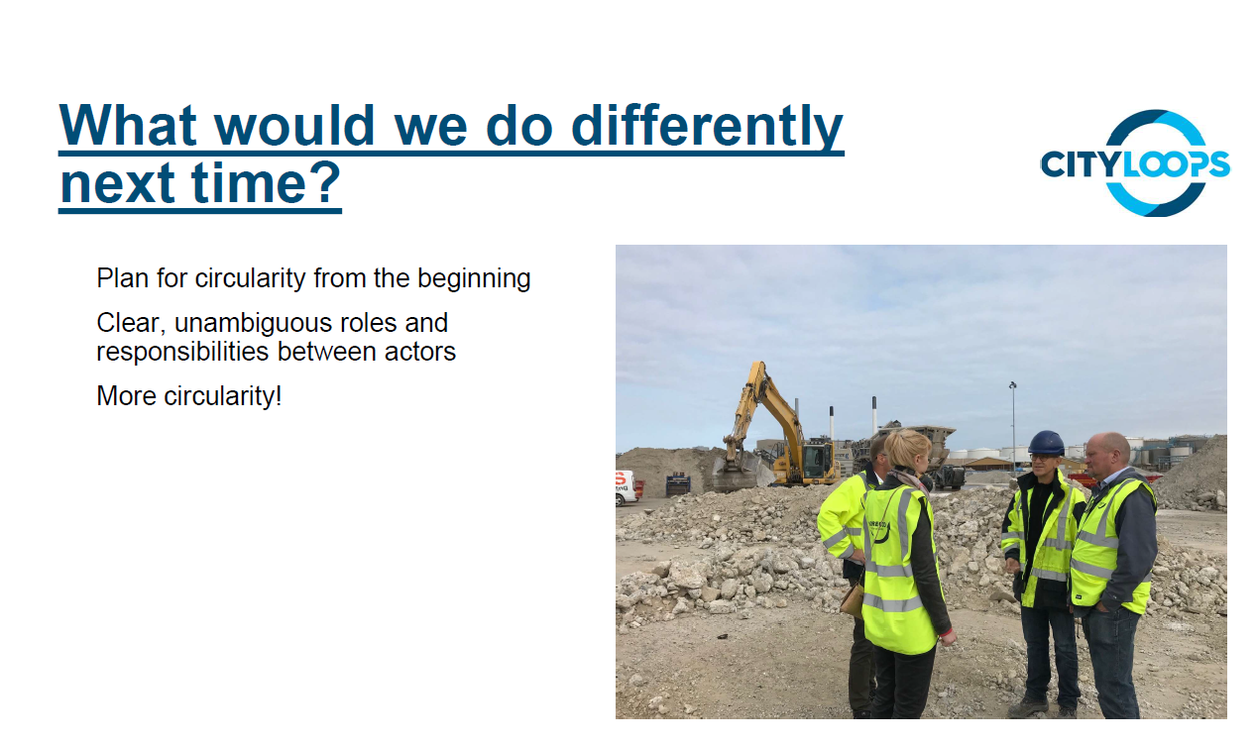

Slide 17
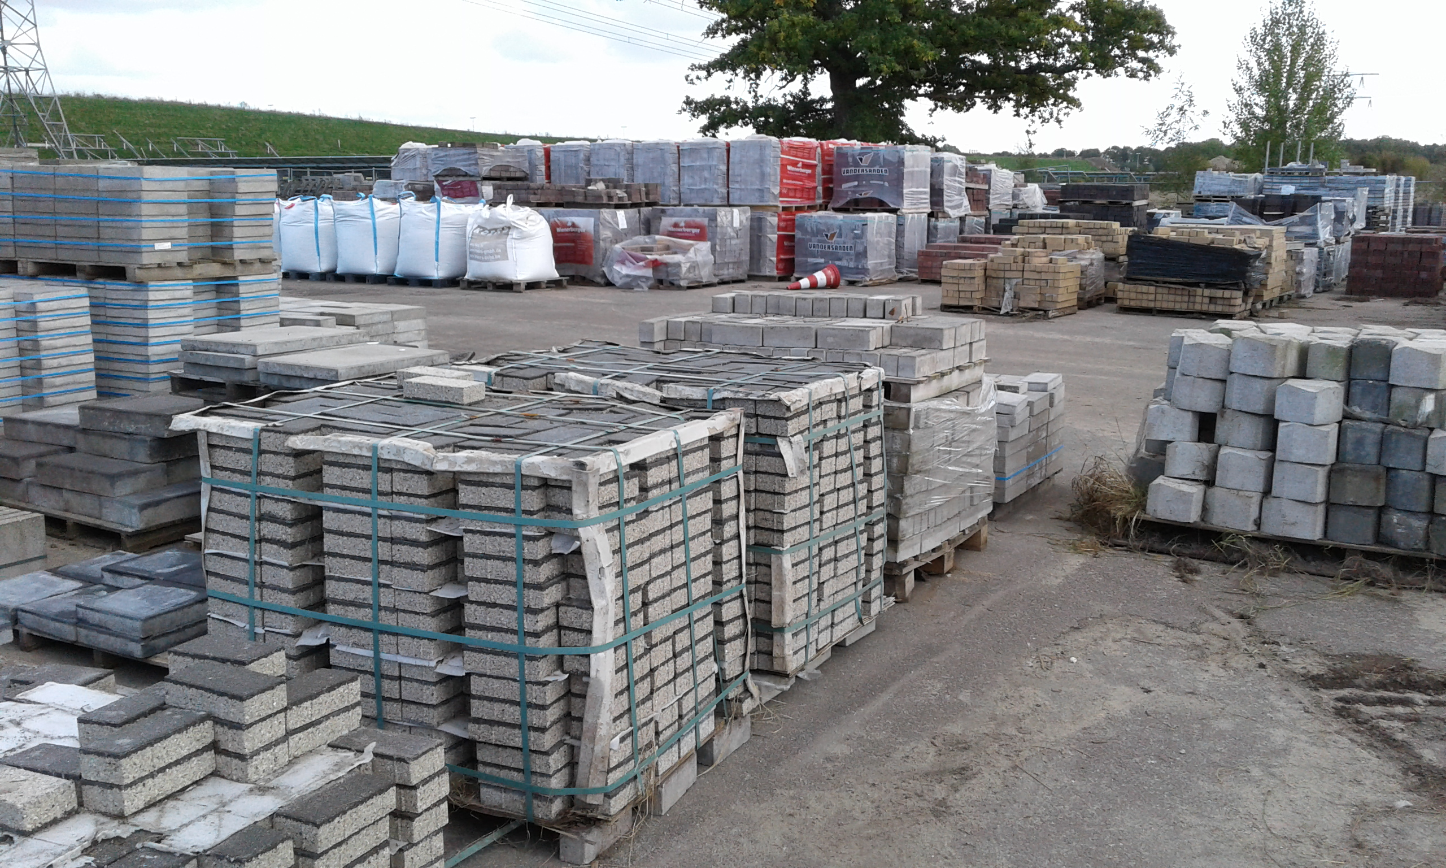
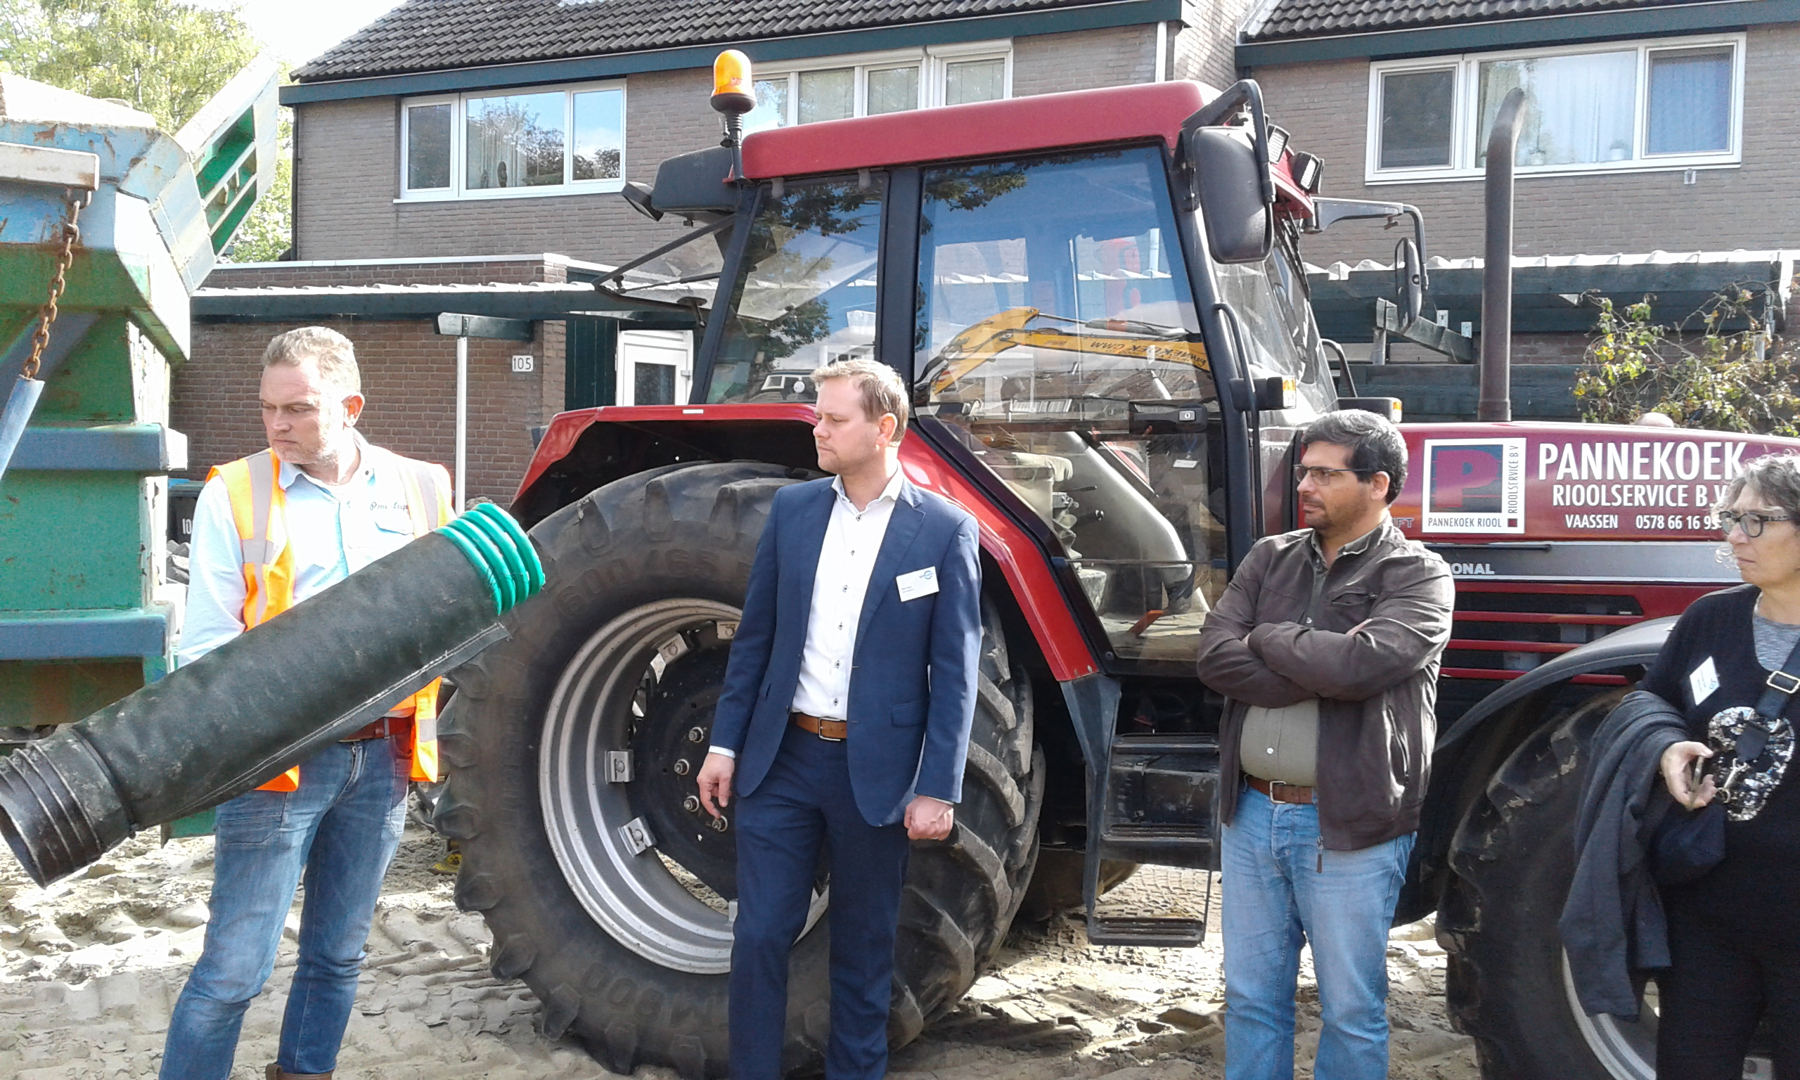
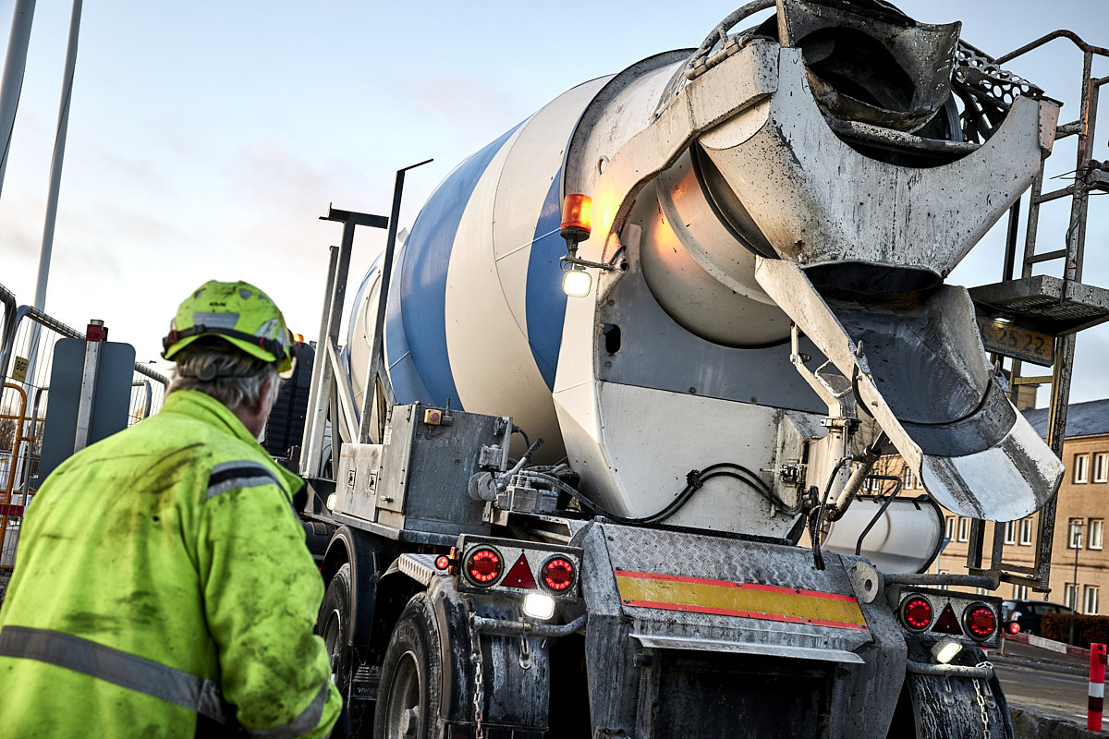
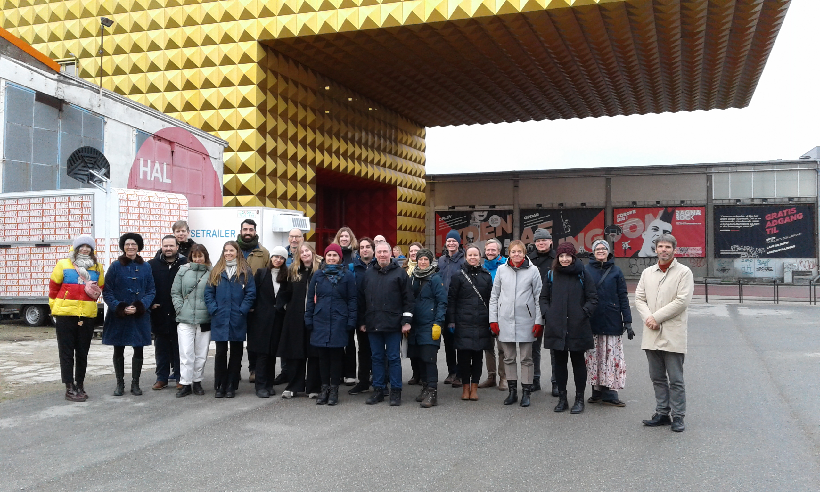
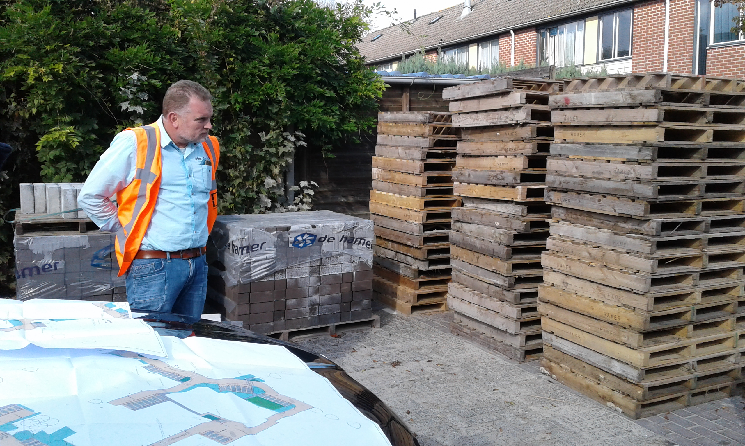
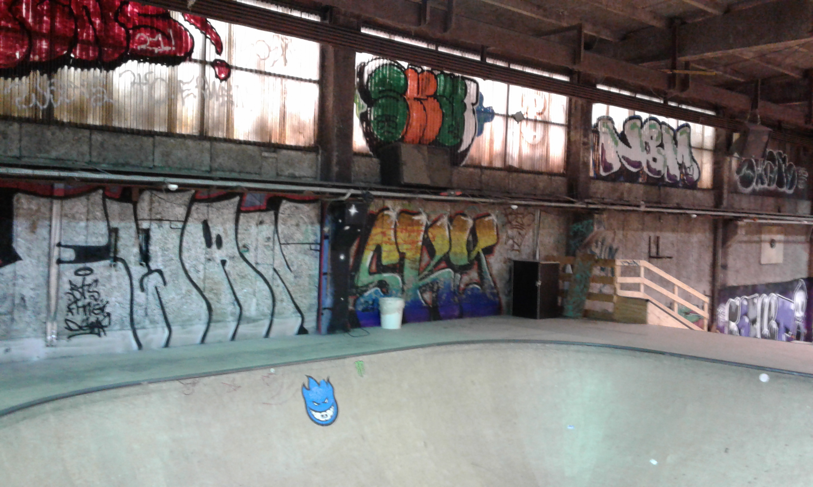
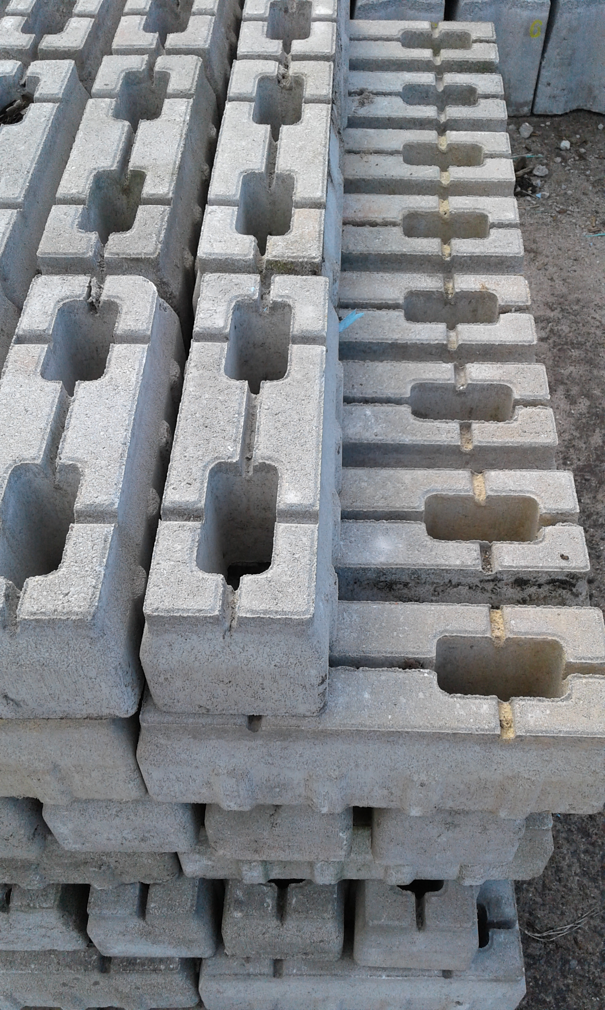
THANK YOU VERY MUCH! www.cityloops.eu

